Slide 1

Immunization Messaging (IZ)
Immunization Information System (IIS)
Test Suite Quick Reference Guide
Robert Snelick
National Institute of Standards and Technology
September 22th, 2015
Contact: rsnelick@nist.gov
Notes:
September

Slide 2
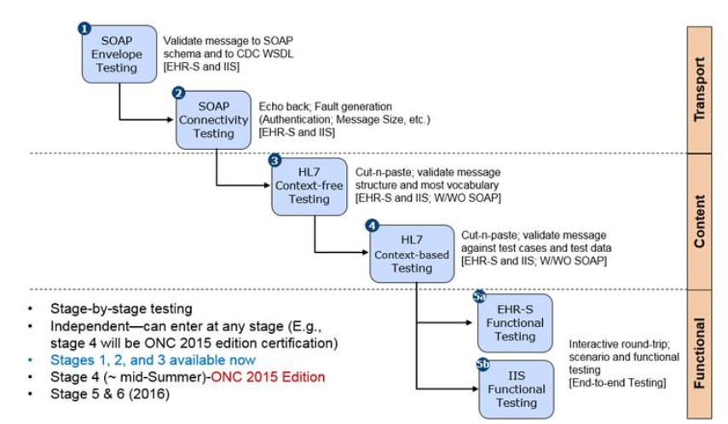
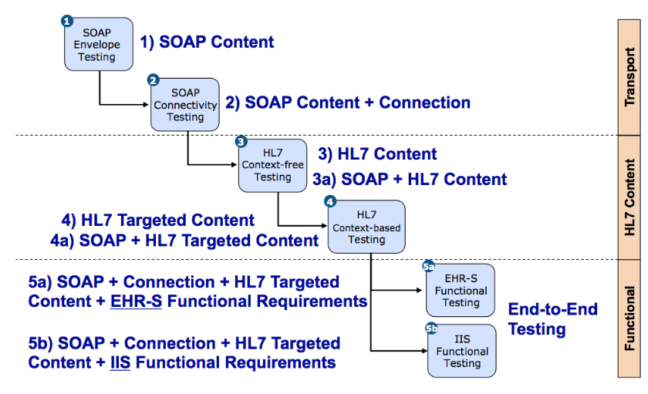
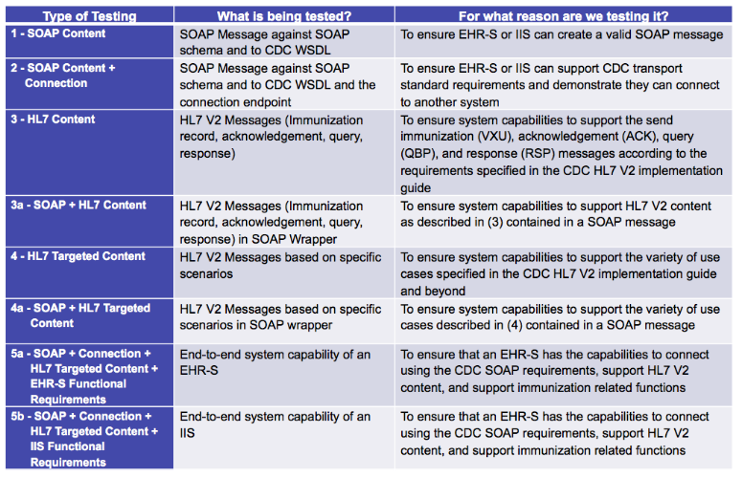
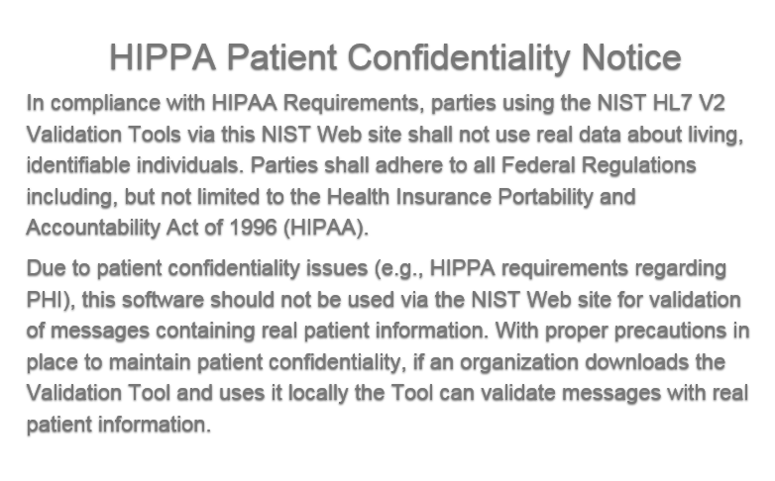
IZ ISS Test Suite Overview
  Purpose: The tool provides end-to-end conformance testing capabilities to validate the conformance of immunization messages to the requirements in the HL7 v2.5.1 Implementation Guide for Immunization Messaging, SOAP Version 1.2 Part 1: Messaging Framework, W3C Recommendation 27 April 2007, Transport Layer Protocol Recommendation Formal Specification, version 1.0, August 25, 2011 and EHR-S and IIS functional Requirements.
  .

Slide 3
Immunization Validation Tool Overview
Tool Key Capabilities
SOAP Envelope Testing | The SOAP Envelop Testing ensures SOAP envelopes are correctly formed, validating the conformance of the messages to the requirements in the SOAP and Transport specifications.
SOAP Connectivity Testing | The SOAP Connectivity Testing evaluates valid SOAP connectivity, the ability to send and receive SOAP messages, validating the conformance of the messages to the requirements in the SOAP and Transport specifications.
Context-Free Testing | Provides a simple and convenient method for testing immunization messages structure and most vocabulary. Validation is perform on messages with or without a SOAP wrapper.
Context-Based Testing | Context-based testing provides, in addition to HL7 Context-free validation, message validation associated with a given test script that includes data for a specific test scenario where the context is known by the validation tool. It also validate messages with a SOAP wrapper.
Isolated Testing | Isolated testing provides a simulated operational environment that allows validation at the functional level in addition to content and context-free testing, where Test Agents simulates the functions of IZ EHR-S or IIS.
  Version: v1.0-beta
  Environment: The IZ ISS Test Suite is currently only accessible as a web application.
  Supported Browsers: Firefox, Chrome and Safari
  URL: http://hit-dev.nist.gov:8098/iztool/#/home

Slide 4
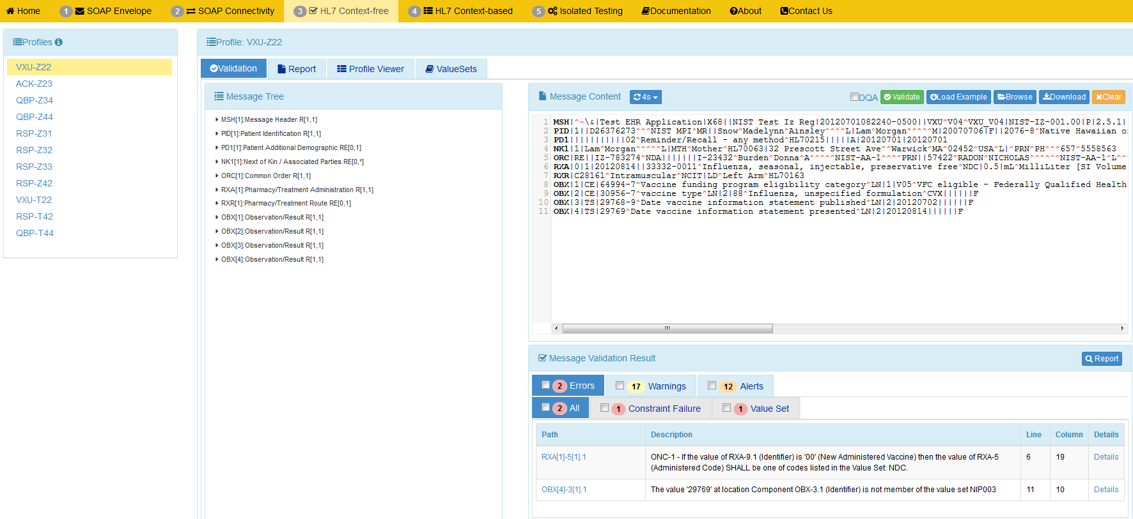
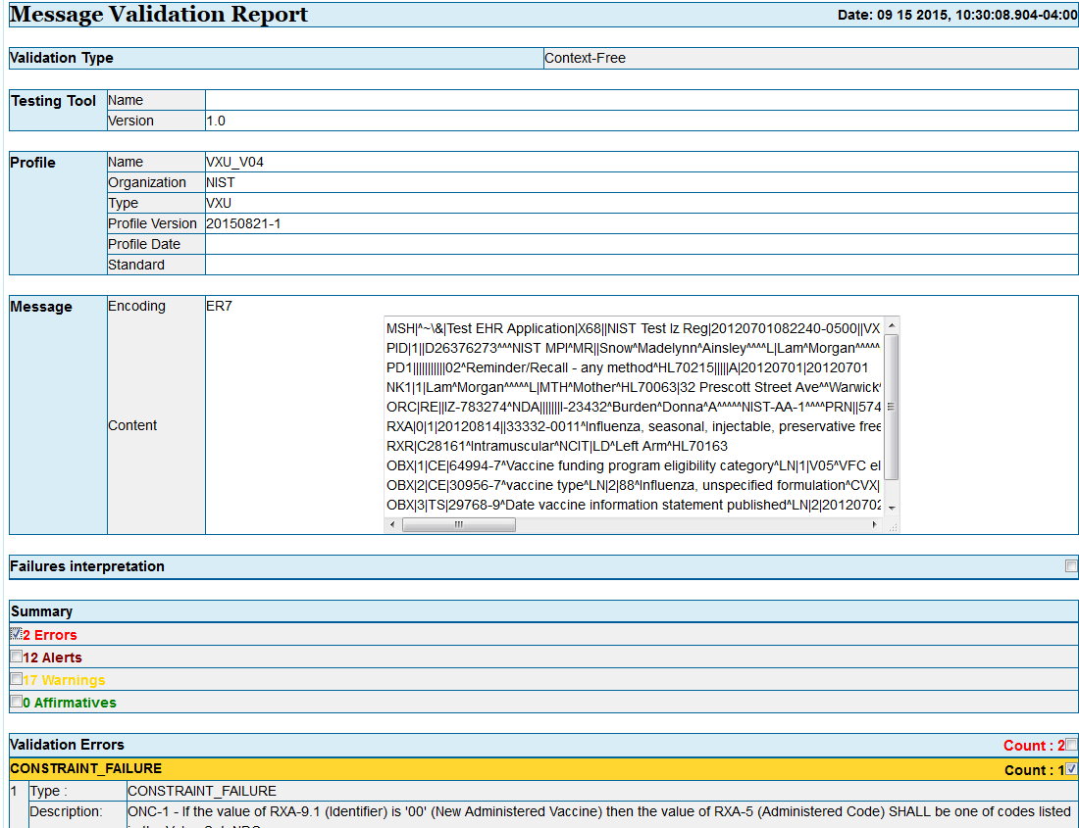
Context-free Testing Quick Guide
Context-free Validation page
This page validates any Immunization message created by the EHR. It is disassociated from a test script, test case, or specific content (test data).
1
2
  Open Immunization Validation tool using link: http://hl7v2-iz-r1.5-testing.nist.gov and click on ‘HL7 Context-free’ tab.
  Select a ‘Conformance Profile’ to test an HL7 message against.
4
Copy/paste or click on Browse Message button to upload test message into Message Content window.
3
Select the ‘Validation’ tab.
5
Validation results appear. If message failed, errors display.
6
Click on ‘Report ‘icon to display Message Validation Report.

Slide 5
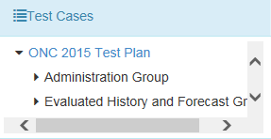
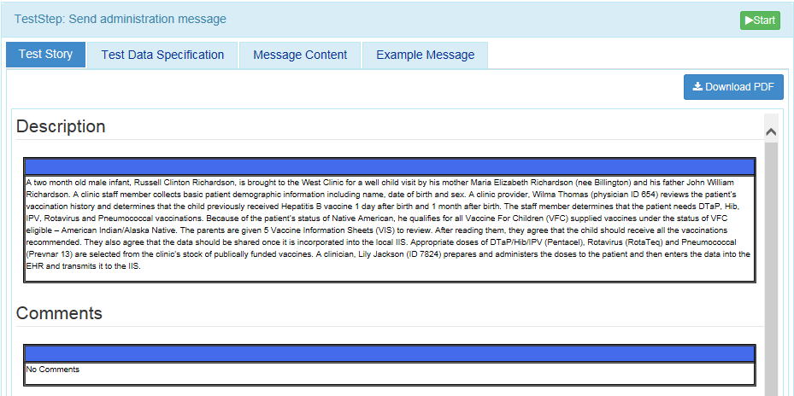
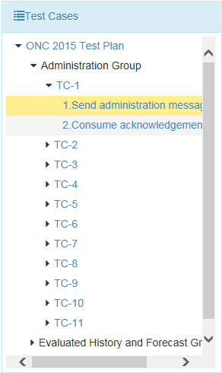
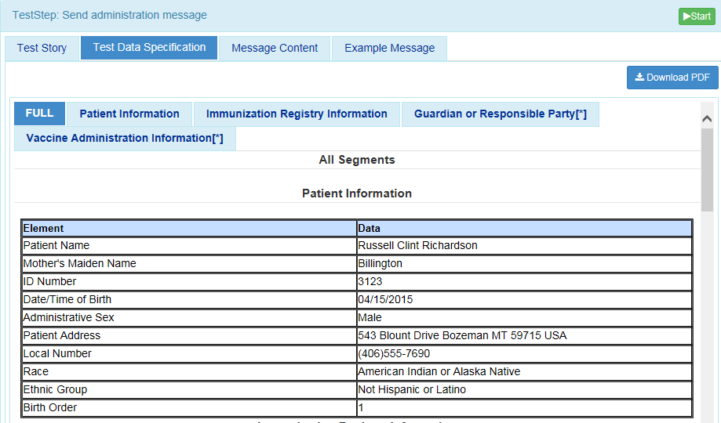
Context-based Testing Quick Guide
Context-based Testing page
This page validates messages associated with a given test script that includes a specific Immunization test scenario. Testing will include the technical requirements and content-specific requirements specified in the Test Case.
2
1
  Select ‘Test Selection’ to view or select a test case.
  Open Immunization Validation tool using link: http://hl7v2-iz-r1.5-testing.nist.gov and click on ‘HL7 Context-based’ tab.
3
  Arrow down ‘Administration Group’ to choose a test case A description of the test case will be displayed.
4
5a
  Select ‘Test Data Specification’. Relevant real world data is displayed.
  Highlight a test step. The description for the test step will be displayed. As a part of the ‘Test Story’.
5b
  Create the test message with the EHR or IIS technology using the test data provided in the “Message Content.” The “Example Message” tab also aids in creating the test message.
6
  Click ‘Start’

Slide 6

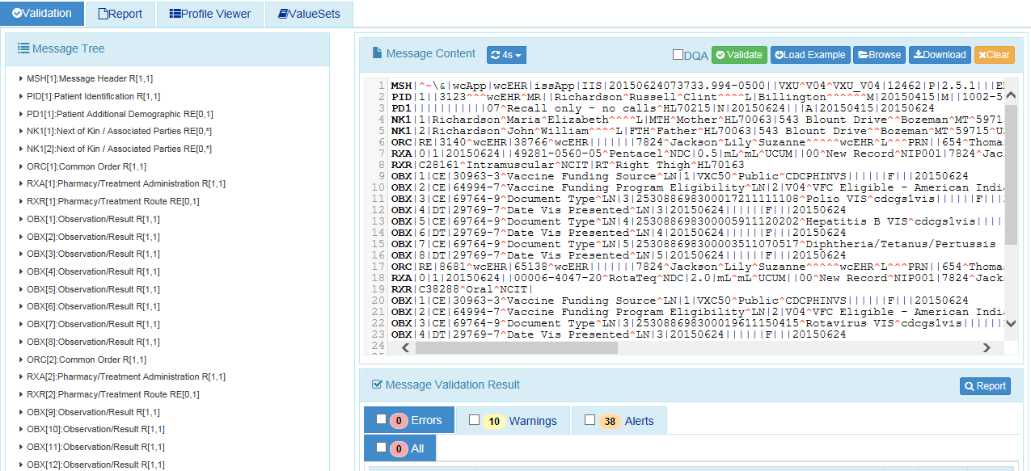
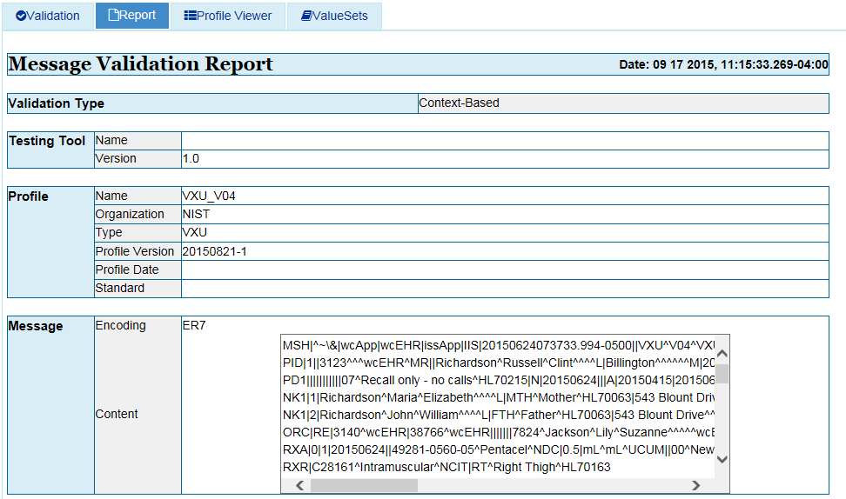
Context-based Testing Quick Guide
7
Context-based Validation page
This page validates any Immunization message created by the EHR. It is disassociated from a test script, test case, or specific content (test data).
  Selecting ‘Start’ will load the test step and send you to the ‘Test Execution’ tab.
8
‘The Message Step will be displayed
9
Copy/paste or click Browse Message button to upload test message into the Message Content window.
10b
The ‘Report’ Tab can also be selected to generate a ‘Message Validation Report’
11
10a
Validation results appear. If message failed, errors display.
Click on ‘Report ‘icon to display Message Validation Report.

Slide 7
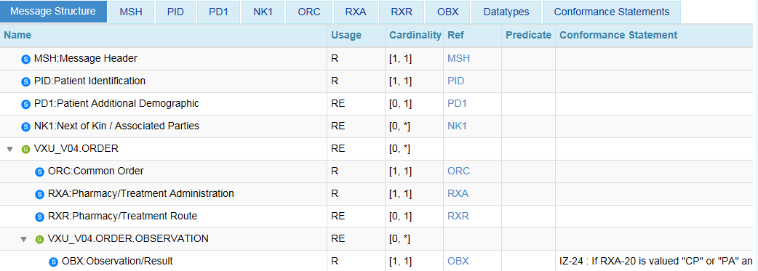
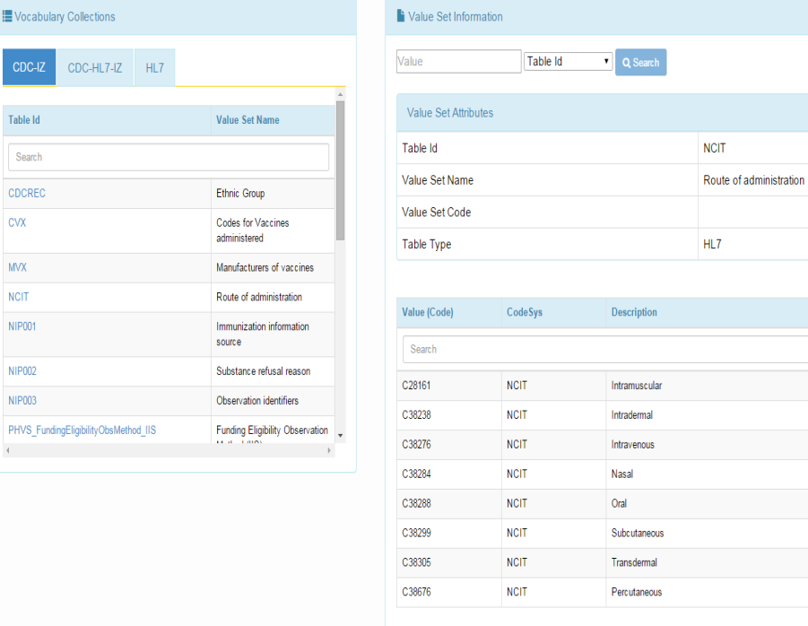
Other Utilities
Profile Viewer page
This page allows tester to view data element information including usage, cardinality, data type, length, table, condition predicate and conformance statements.
Value Sets page
This page provides the ability to browse the vocabulary requirements. Search capabilities are provided and include searching on value, table name, table ID and description.
1
2
Select the ‘Profile Viewer’ tab.
Select the ‘Value Sets’ tab.
Notes:
Fix all images; Sheryl commented too small to read

